Slide 1
Benefits of Intermediate Annotations in Reading Comprehension
김주찬

Slide 2
Purpose
To show importance of Intermediate Annotation in RC

Slide 3
Main contribution of intermediate annotation
Annotating relevant text spans can provide easy and low coast way to learn better latent reasoning
Annotations can help combat biases
Intermediate annotation will be useful for training further models

Slide 4
Intermediate Annotations
Describe the right set of context spans that should be aggregated to answer a question
How to collect?: crowd-sourcing
Cost?: 1$ for 10 annotations.
Notes:
모든 event span을 다 annotat했다.

Slide 5
Experiment
Supervised model with annotation by jointly prediction intermediate annotation and the final answer
Evaluated Cost vs Benefit and Bias

Slide 6
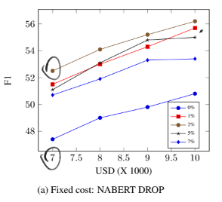
Result: Cost
Allocating a large percentage of budget reduce performances

Slide 7
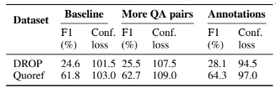
Result: Bias
F1: How accurate the model is on the unbiased evaluation
Confusion Loss: Evaluate the extent to which the errors made by model are unbiased(Error Diffusion)
Computing highest singular value of unnormalized confusion matrix agter setting diagonal elements to 0
Lower confusion loss = more diffusion
Baseline < More QA pairs < Annotation

